Slide 1


Language Processing for Matter and Technology
10th annual meeting of the Matter and Technologies
HZB Berlin
Antonin Sulc

Slide 2
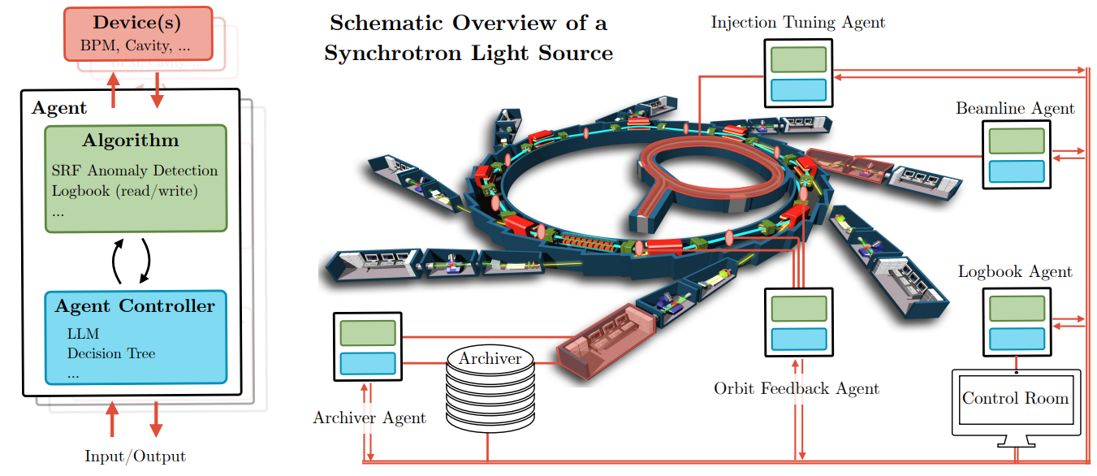
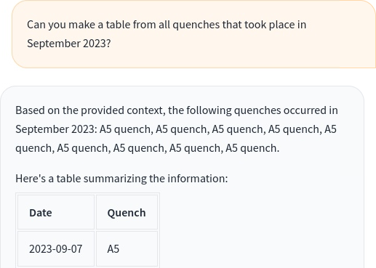
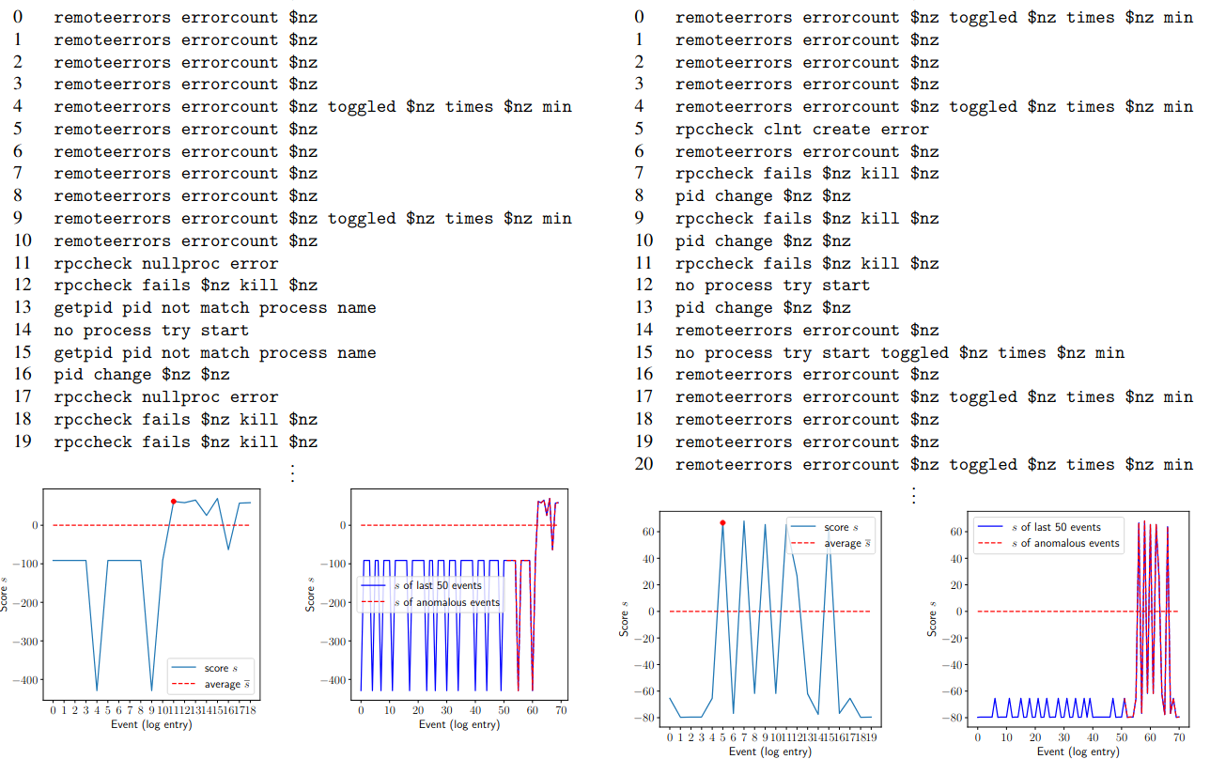
Language for Matter and Technology?
How to detect anomalies in logs
How can we enhance logbooks
What the future autonomous control might look like
Notes:
Upper right: © HZB/Dirk Laubner: Aerial view of BESSY II
Below: © HZB/Kevin Fuchs: Experimental hall BESSY II

Slide 3
Log Analysis

Slide 4
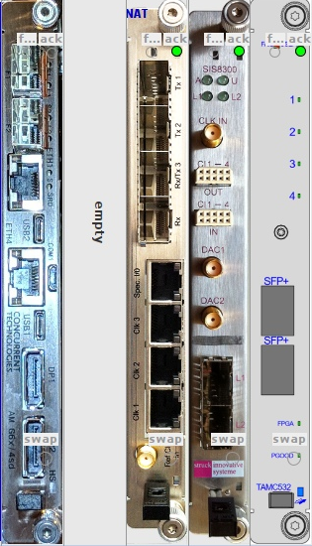
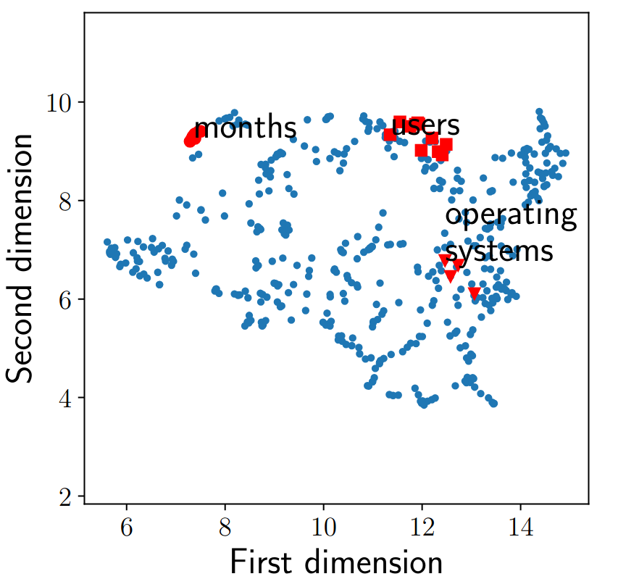
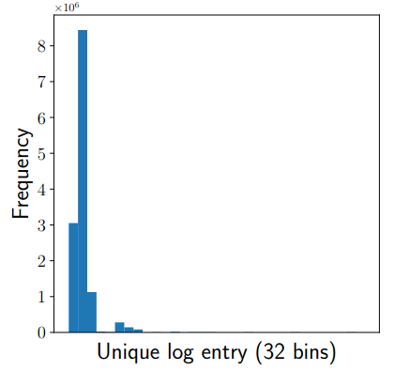
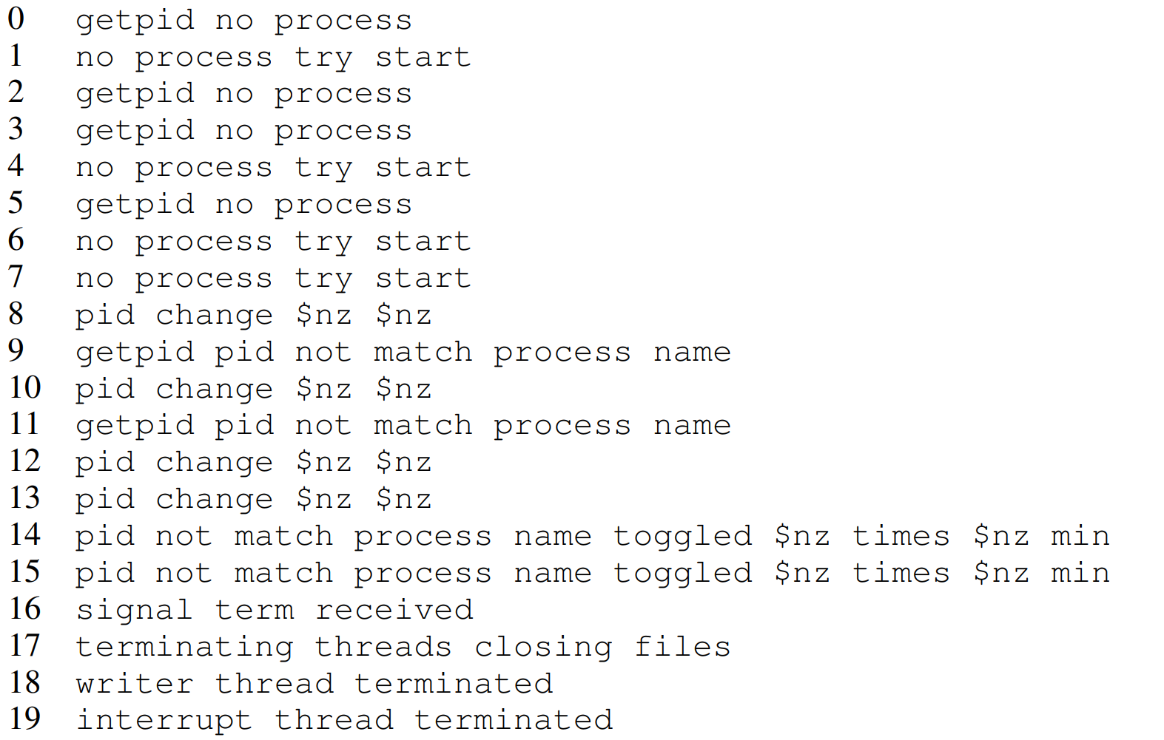
Log Anomaly Detection
Manual log analysis can be time-consuming.
Early issue detection prevents system failures.
Traditional methods struggle with log data:
Too few unique words (~470 unique words)
Too few unique log entries
Uninformative messages
no error
Approach Unsupervised method w2v+HMM:
Embed logs with w2v
Model this sequence as HMM
Detect anomaly
Detects anomalies based on sequence likelihood of a new message
https://arxiv.org/abs/2310.08951

Slide 5
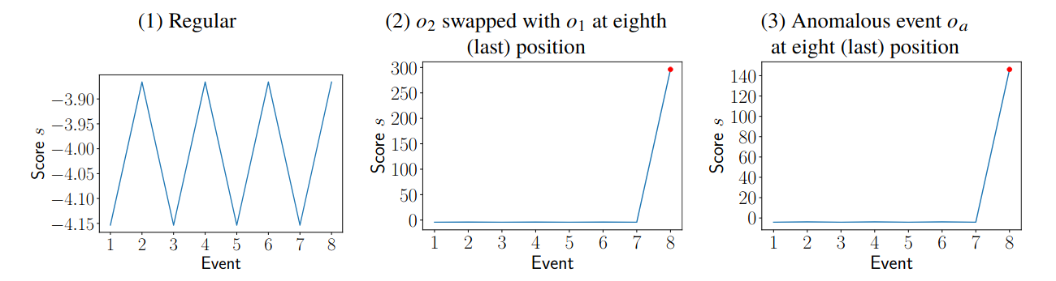
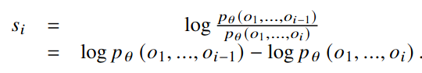
Log Anomaly Detection
Detects anomalies based on sequence likelihood of a new message
(2 1 2 1 2 1 2 1 2)
(2 1 2 1 2 1 2 1 1)
(2 1 2 1 2 1 2 1 3)

Slide 6
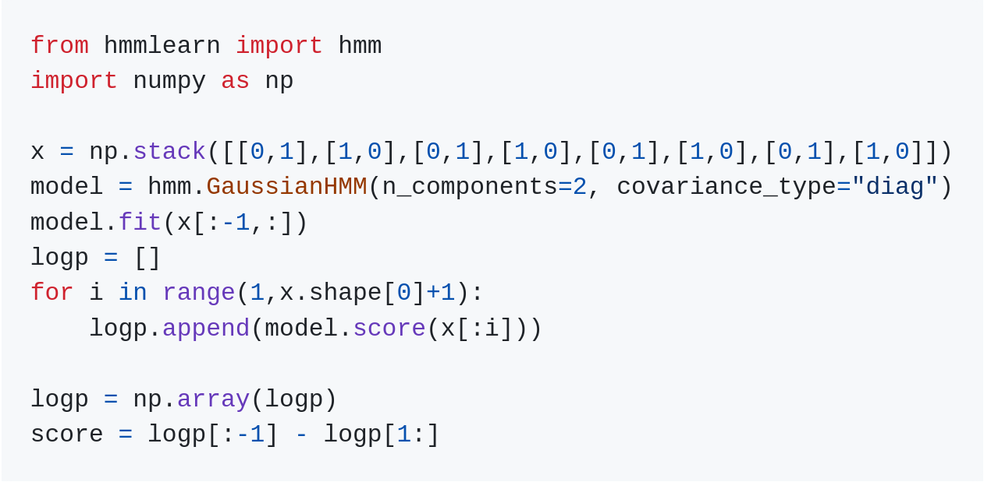
Log Anomaly Detection

Slide 7
Log Anomaly Detection

Slide 8
Logbook 2.0

Slide 9
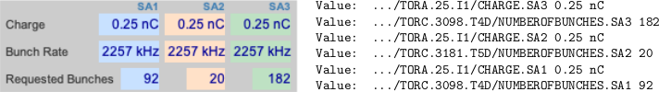
Logbook 2.0
Logbook 1.0
Full-text search i.e.
Quench≠Quenches
Entries are (often) minimalist
A5 quench
LLMs are very powerful!
Relevant information in screenshots and metadata.

Slide 10
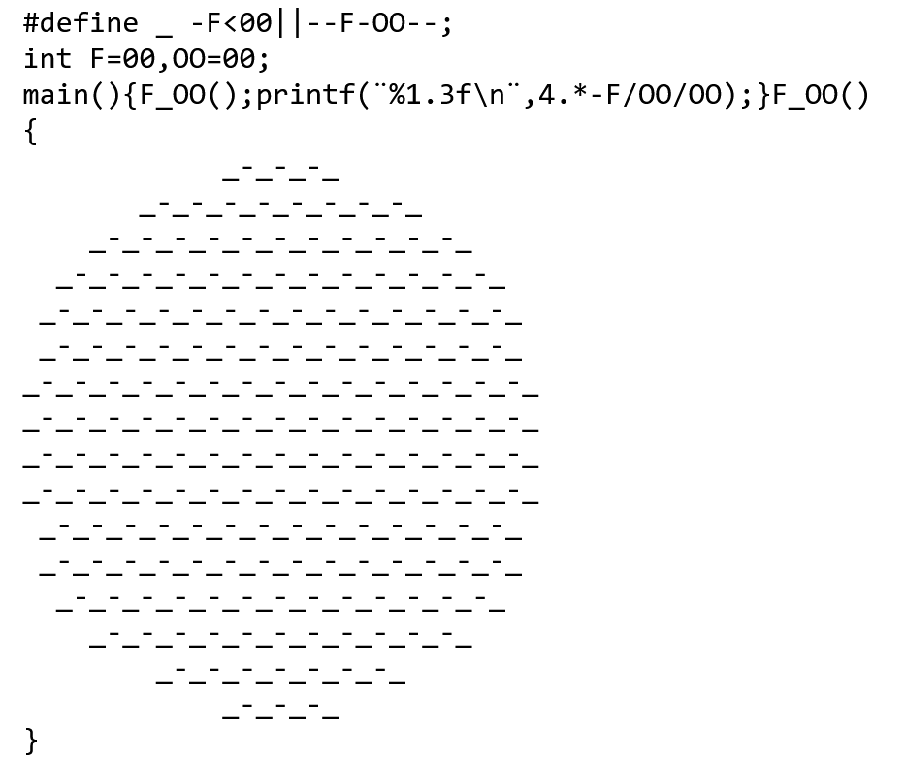
Logbook 2.0
Logbook 1.0
Full-text search i.e.
Quench≠Quenches
Entries are (often) minimalist
A5 quench
LLMs are very powerful!
Relevant information in screenshots and metadata.
LLM (Llama 3.0 405b):
The output of the program will be a value close to pi (3.141), because the expression 4.*-F/OO/OO approximates the Leibniz formula for π
International C Obfuscation Competition Winner
Metadata values via
OCR
Storing the metadata

Slide 11
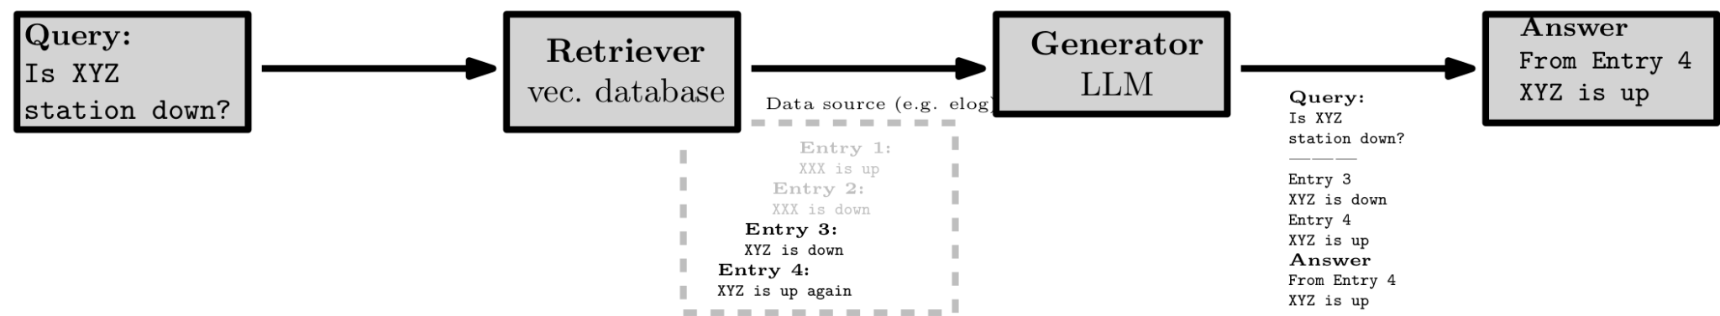
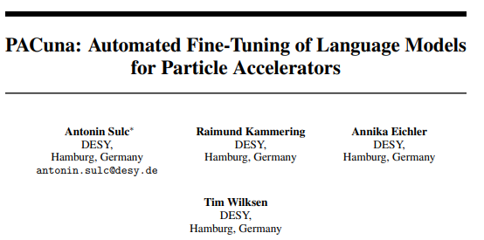
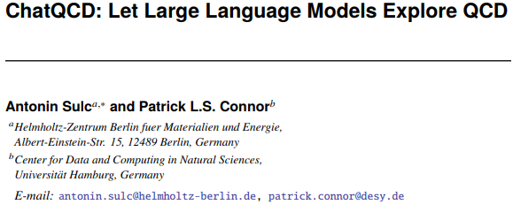
Logbook 2.0 - Putting Everything Together
Allows searching through
Databases
Setting catalogues.
Multimodal data
Code databases
Working with all the mess that Retriever gives.
Generator (LLM fine-tuning?)

Slide 12







Logbook 2.0

Slide 13
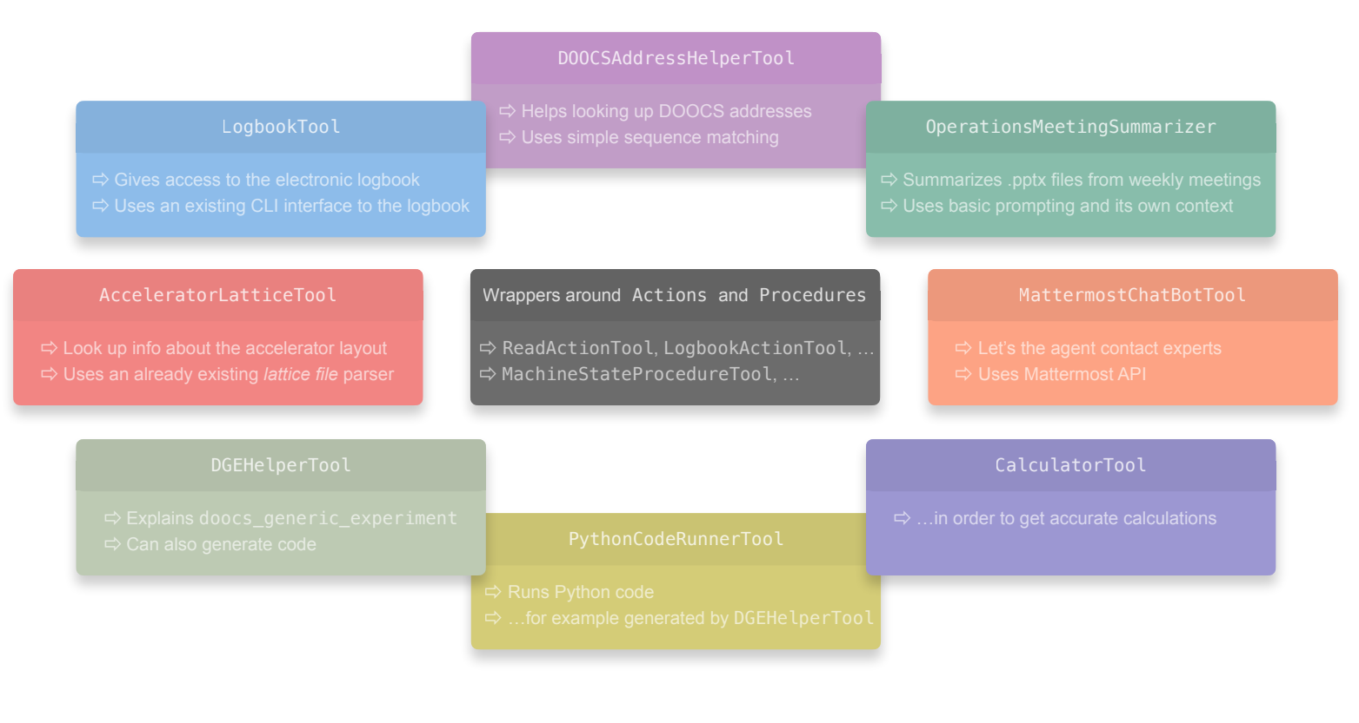
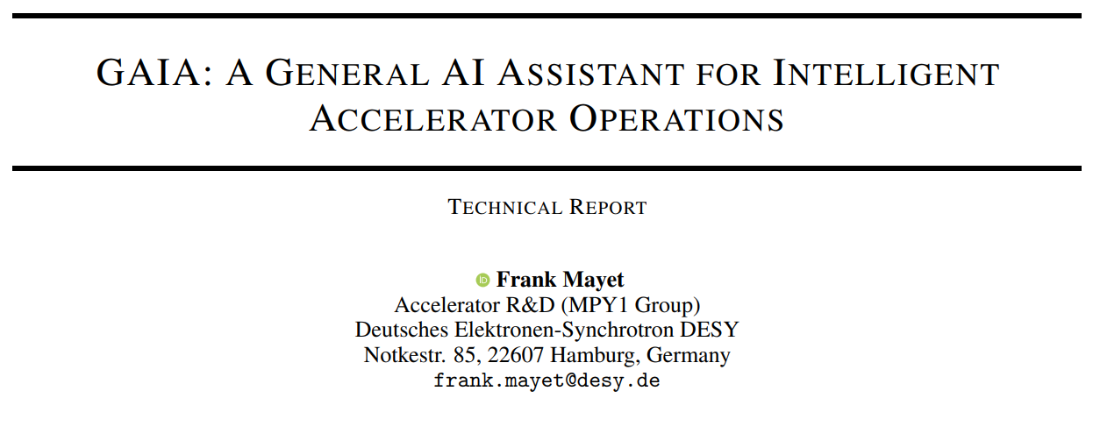
Logbook 2.0 - GAIA
https://arxiv.org/abs/2405.01359

Slide 14
Towards Autonomous Accelerators
Logbook was just beginning ….

Slide 15
Autonomous Accelerator - Autonomous Agents
LLLs are good in so many ways
Many good algs. (e.g. anomaly detection, feedback…)
The idea is
Use LLM as a controller (brain) of an agent.
Use algorithm (e.g. anomaly detection, feedback)
If something happens controller decides what to do
Decentralized + Highly modular
https://arxiv.org/abs/2409.06336

Slide 16
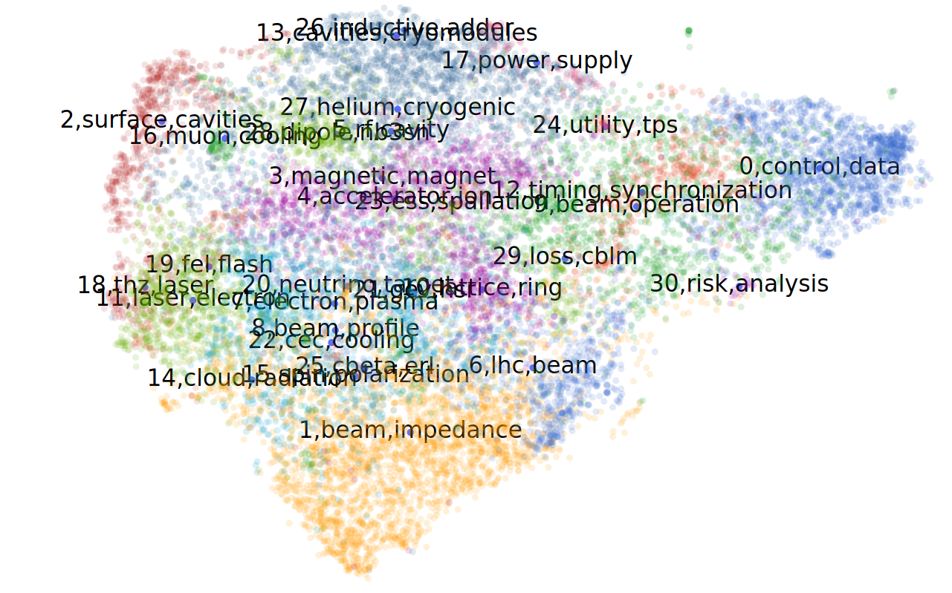
Particle Accelerators and NLP - The Bird’s View
Growing volume of research papers challenges staying current
NLP techniques can reveal trends in scientific literature
Topic modeling and graph analysis to conference proceedings
Trained a domain-specific semantic search model.
Revealed research trends and influential papers in accelerator science (most of them are status papers)
https://arxiv.org/abs/2310.08954

Slide 17
Conclusion & Summary
Log anomaly detection using word2vec and HMMs
Logbook 2.0 with LLM-enhanced search and interpretation
Integrated multi-source search system
LLM-controlled autonomous accelerator agents
NLP analysis of accelerator science literature
https://sulcantonin.github.io

